Slide 1

Smart Podcast Generation from Academic
Research Papers
Team No: 06​
Presented By
Priyanka Badiger 01FE23BCS182​
Aishwarya Talikoti 01FE24BCS189​
Preeti Chalawadi 01FE23BCS154​
Shrutika Ambure 01FE23BCS198
Under the Guidance Of:
Asst.Professor GuruPrasad ​

Slide 2
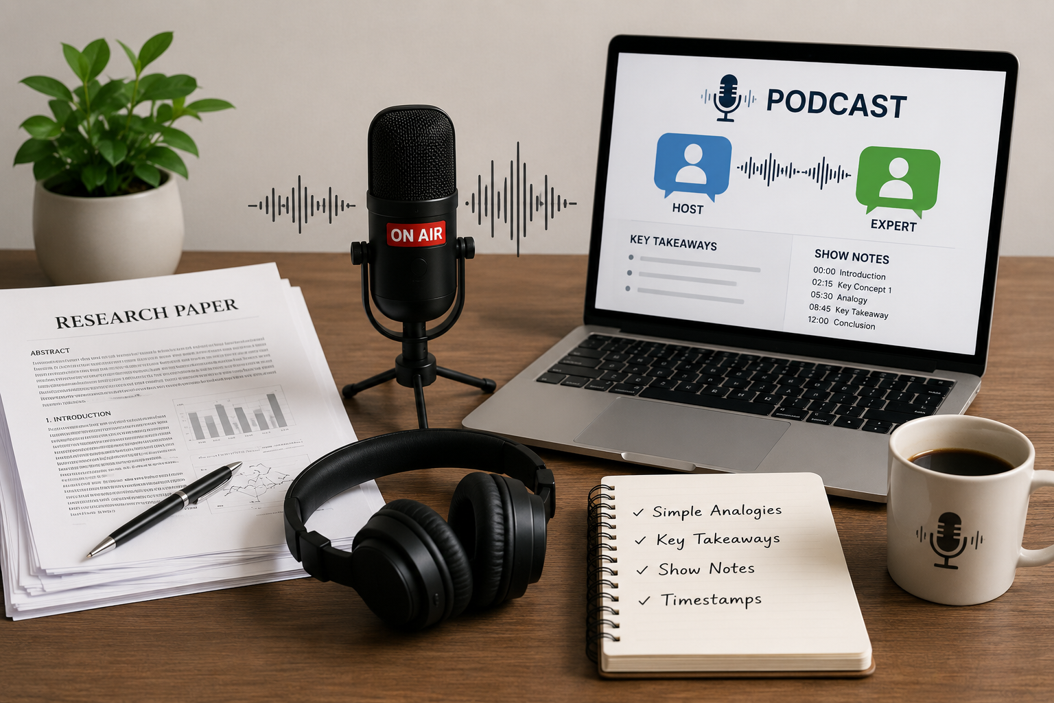
Introduction
Research papers contain valuable scientific knowledge, but their technical language and complex structure often make them difficult for students, researchers, and the general public to understand. At the same time, podcasts have become one of the most popular and accessible formats for consuming information, allowing people to learn while commuting, exercising, or performing daily activities.
This project, leverages Generative AI to bridge the gap between academic research and public understanding. The system automatically converts research paper PDFs into engaging podcast episodes by generating a structured host–guest conversation, listener-friendly analogies, key takeaways, and detailed show notes with timestamps.
By transforming dense academic content into an easy-to-understand audio-friendly format, the proposed solution enhances science communication, improves knowledge accessibility, and enables researchers to reach a broader audience efficiently.

Slide 3
Problem Statement
The increasing volume of research publications makes it difficult to communicate scientific findings effectively. Research papers are often lengthy and technical, limiting accessibility. This project proposes a GenAI-based solution that converts research papers into podcast-style content with dialogues, key takeaways, show notes, and audio generation.
Objectives
​To extract and analyze content from research papers.
To identify key contributions and research gaps.
To convert research papers into podcast-style conversational content
To generate show notes, key takeaways, and timestamps.
To transform generated scripts into downloadable audio podcasts.

Slide 4
Proposed Solution
User uploads a research paper PDF into the system.
The system extracts text from the uploaded document using PyPDF.
Llama 3.3 70B analyzes the paper to identify the problem, methodology, findings, and research gap.
The Scientific Lay Summarisation Dataset helps convert technical content into easy-to-understand explanations.
The system generates podcast scripts, show notes, key terms, timestamps, and audio output for better accessibility.

Slide 5
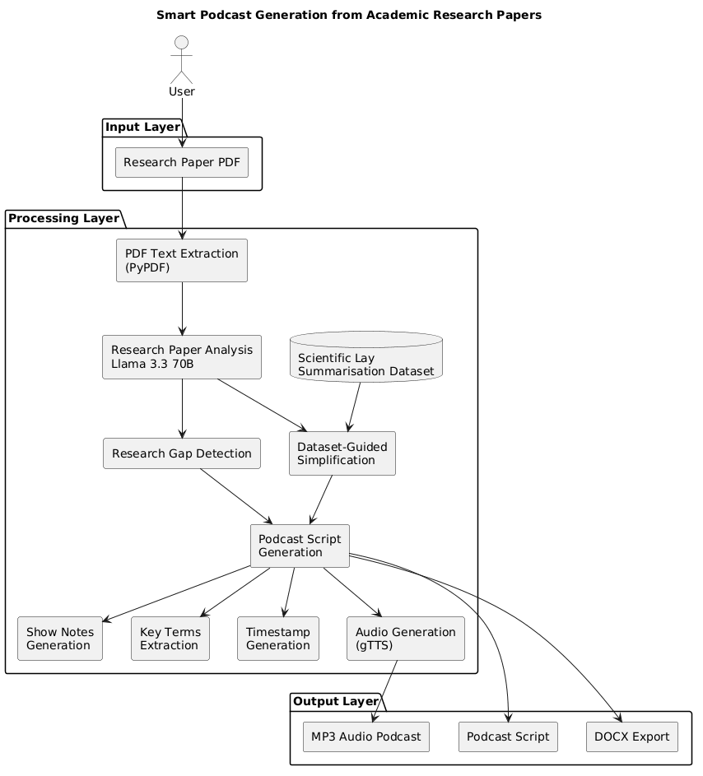
Architecture

Slide 6
Methodology
Step 1: Research Paper Upload
The user uploads a research paper PDF through the Streamlit-based interface.
Step 2: PDF Text Extraction
The uploaded PDF is processed using PyPDF2 to extract textual content from all pages.
Step 3: Text Preprocessing
The extracted text is cleaned, segmented into manageable chunks, and prepared for AI processing.
Step 4: Research Paper Analysis
The processed content is analyzed using a Generative AI model (Gemini/Llama) to identify the main concepts, methodology, findings, and conclusions.
Step 5: Podcast Script Generation
The AI model converts the research content into a structured Host–Guest podcast conversation.
Step 6: Analogy and Key Takeaway Generation
Listener-friendly analogies and concise key takeaways are generated to simplify complex research concepts.
Step 7: Show Notes and Timestamp Creation
The system automatically creates organized show notes, timestamps, and key terms for easy navigation.
Step 8: Output Generation
The final outputs include a podcast script, show notes, key terms, analogies, and downloadable DOCX or audio files.

Slide 7
Dataset Used
Dataset , Tools and Technologies
Technologies Used​
AI Model: Llama 3.3 70B​
Used For:​
Paper Analysis ​
Research Gap Detection ​
Podcast Generation ​
Show Notes ​
Timestamp Generation ​ ​
Tools​
Streamlit ​
PyPDF ​
Groq API ​
Python​
Scientific Lay Summarisation Dataset
Features
24,000+ scientific articles
Human-written lay man summaries
Converts technical content into simple language
Why this Dataset?
Improves readability
Generates listener-friendly explanations

Slide 8
Implementation
Frontend Implementation
Developed using Streamlit for an interactive web interface.
Supports PDF upload and podcast style selection.
Displays generated analysis, research gaps, and podcast outputs.
Backend Implementation
Implemented in Python.
PyPDF extracts text from uploaded research papers.
Text preprocessing prepares content for AI analysis.
Dataset Integration
Scientific Lay Summarisation Dataset used to create easy-to-understand explanations and listener-friendly content.
AI Integration Module
Integrated Groq API with Llama 3.3 70B.
Designed prompts for:
Paper analysis
Research gap identification
Podcast generation
Managed communication between the application and AI model.
Audio & Export Module​
gTTS (Google Text-to-Speech) converts podcast scripts into audio. ​
python-docx generates downloadable DOCX files. ​
MP3 audio files are generated for podcast listening. ​​

Slide 9
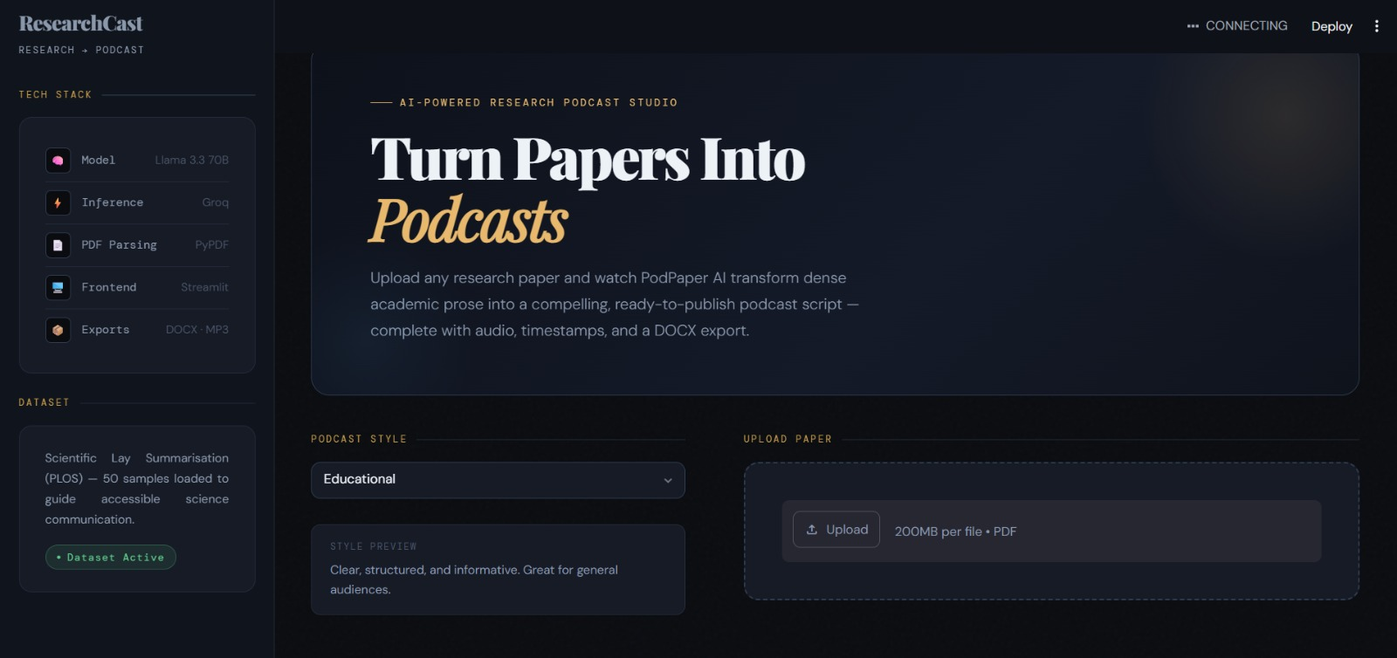
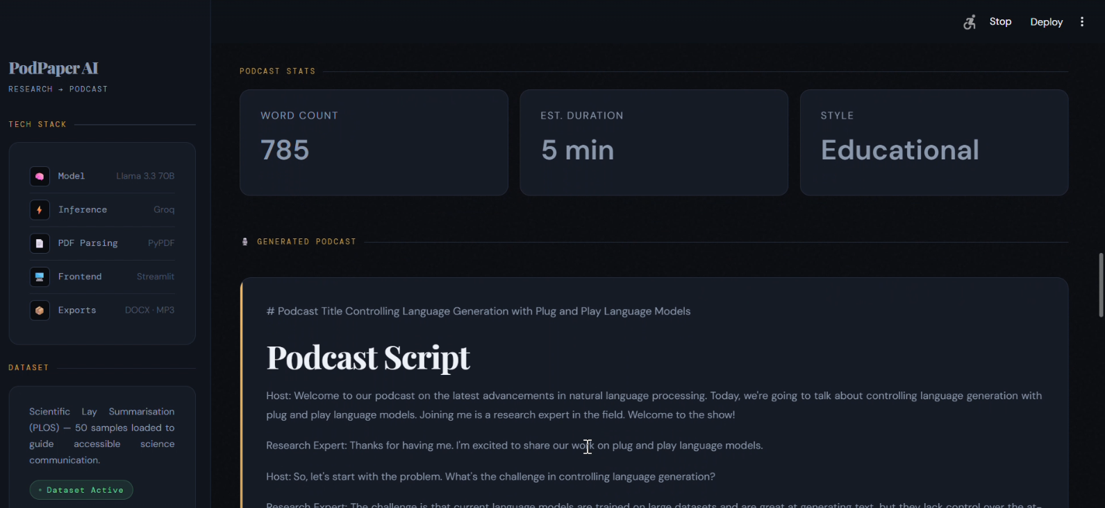
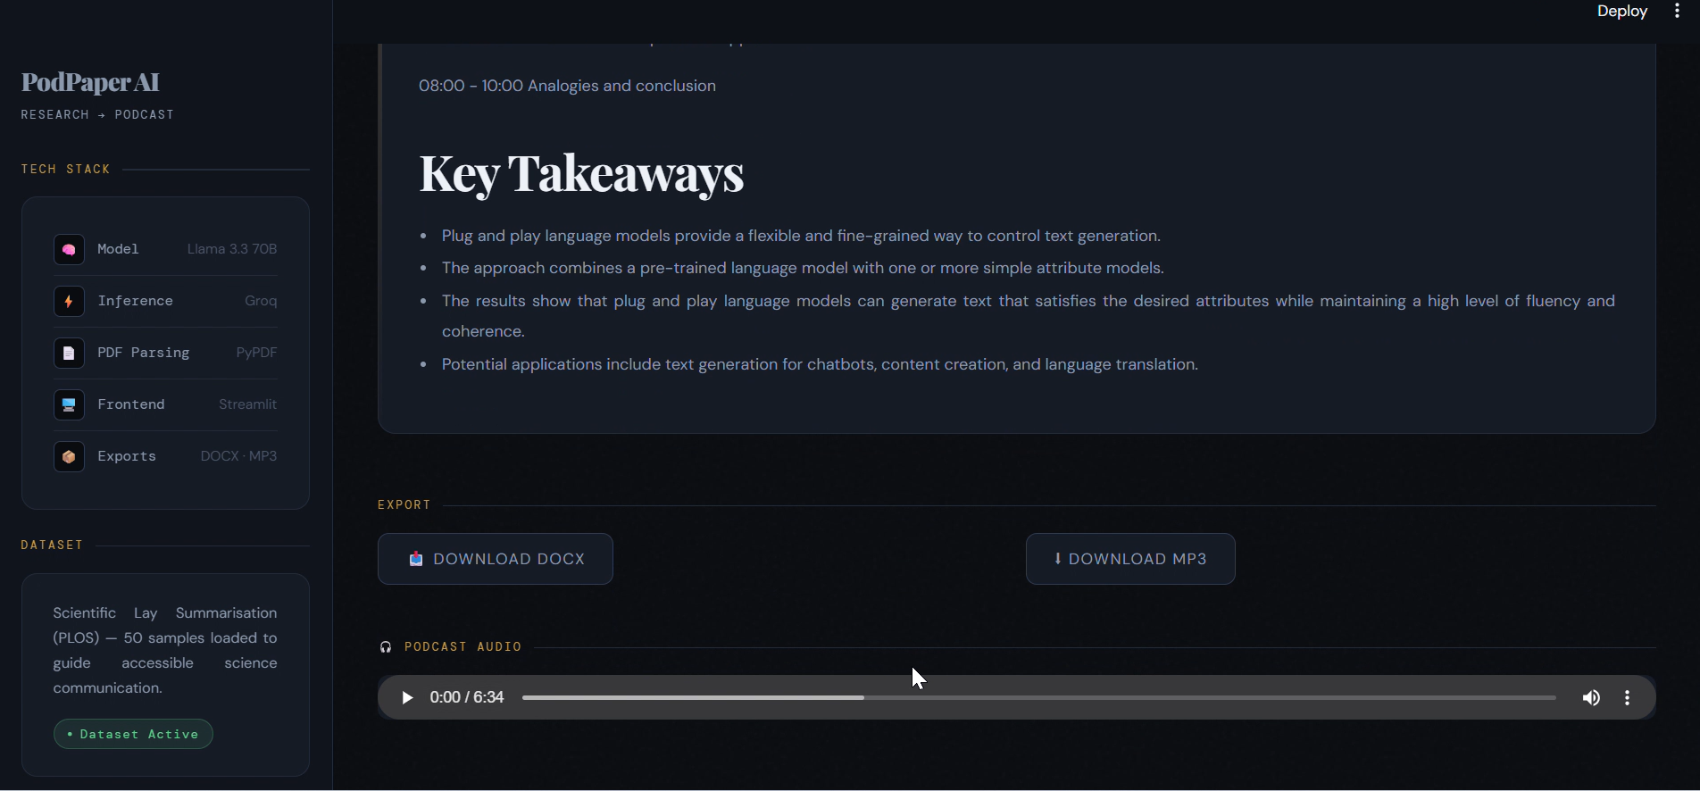
Results and Outputs
Generated Outputs
Successfully extracted and analyzed research paper content.
Identified problem statement, methodology, key findings, and research gaps.
Generated podcast-style Host–Expert conversational scripts.
Created listener-friendly analogies, key takeaways, and show notes.
Automatically generated chapter-wise timestamps.
Produced downloadable DOCX and MP3 podcast outputs.

Slide 10
Conclusion
Smart Podcast Generation from Academic Research Papers is a Generative AI–based solution that converts complex research papers into engaging podcast-style content. By analyzing research papers, identifying research gaps, and generating podcast scripts, show notes, key terms, and timestamps, the system makes scientific knowledge more accessible and easier to understand. This project helps students, researchers, and professionals consume research content efficiently, while future enhancements will include audio generation and improved user experience.
Future Scope
Support for multiple languages.
More natural AI voice generation and voice cloning.
Mobile application development.
Integration with podcast platforms such as Spotify.
Enhanced analysis of research figures, tables, and charts.
Personalized podcast generation based on user preferences.

Slide 11
THANK YOU

